Slide 1
БИОРАЗНООБРАЗИЕ И ФУНКЦИОНИРОВАНИЕ ВОДНЫХ ЭКОСИСТЕМ
Отдел ультраструктуры клетки
Лимнологический нститут СО РАН
Шишлянников Сергей Михайлович

Slide 2
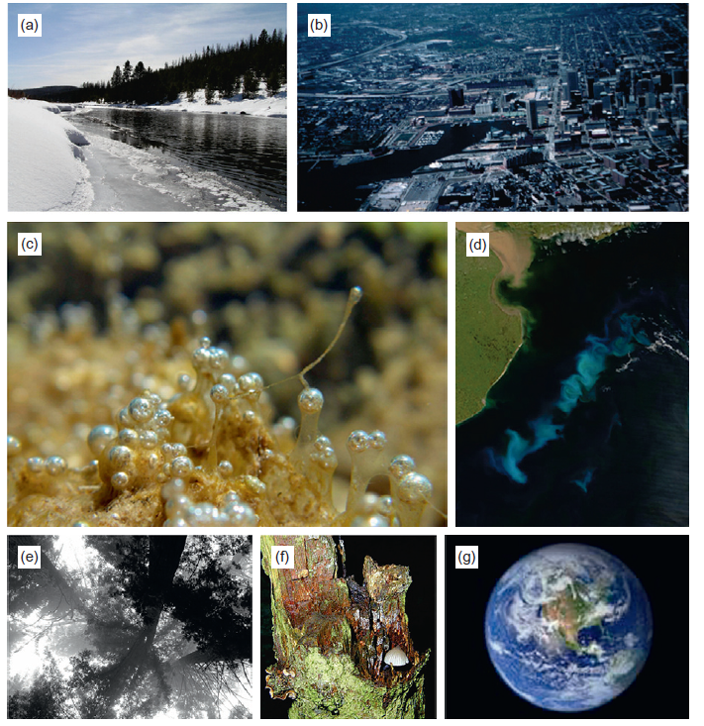
НЕКОТОРЫЕ ПРИМЕРЫ ЭКОСИСТЕМ
Notes:
Some examples of ecosystems: (a) the frigid Salmon River, Idaho; (b) a residential neighborhood in
Baltimore, Maryland; (c) a biofilm on a rock in a stream; (d) a section of the southern ocean containing a phytoplankton
bloom; (e) a redwood forest in the fog in California; (f) a tree cavity; (g) the Earth

Slide 3
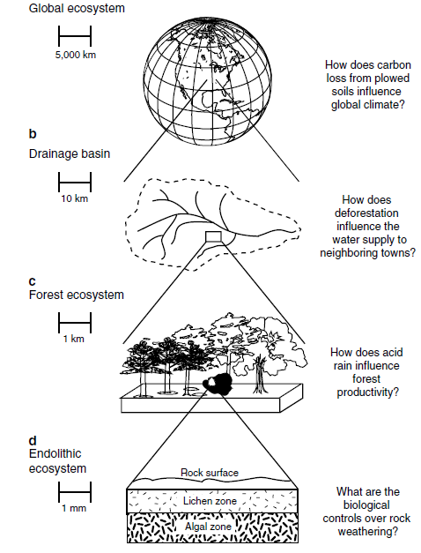
Principles of Terrestrial
Ecosystem Ecology
Notes:
Examples of ecosystems that range in size by ten orders of magnitude: an endolithic ecosystem in the surface layers of rocks (1 . 10−3 m in height), a forest 1 . 103 m in diameter, a drainage basin (1 . 10 5 m in length), and Earth (4 . 107 m in circumference). Also shown are examples of questions appropriate to each scale

Slide 4
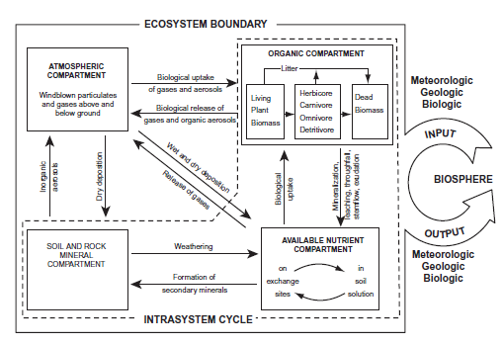
FUNDAMENTALS
OF ECOSYSTEM SCIENCE
Notes:
Two views of the same ecosystem. The left side shows some of the parts inside an ecosystem and
how they are connected, as well as the exchanges between the ecosystem and its surroundings, whereas the right
side shows a black-box approach in which the functions of an ecosystem (i.e., its inputs and outputs) can be studied
without knowing what is inside the box. (Modified from Likens 1992.)

Slide 5
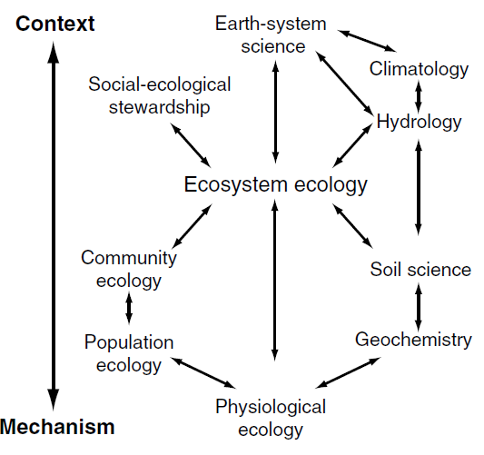
Principles of Terrestrial
Ecosystem Ecology
Notes:
Relationships between ecosystem ecology and other disciplines. Ecosystem ecology integrates the principles of several biological and physical disciplines, determines
the resources available to society, and provides the mechanistic basis for Earth-System science

Slide 6
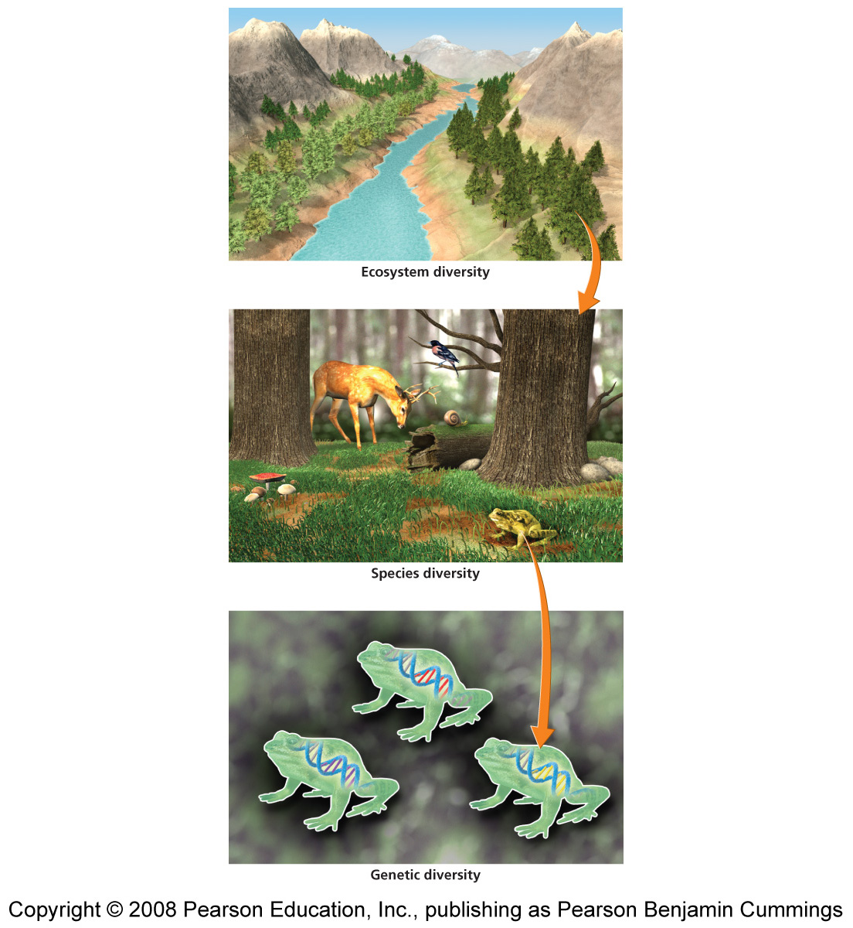
БИОРАЗНОБРАЗИЕ
Разнообразие живых организмов, видов
Экологическое разнообразие
  Места обитания, ниши, межвидовые взаимодействия
Разнообразие видов
  Различные виды организмов, число видов
Генетическое разнообразие
  Разнообразие генов и их комбинаций внутри популяции и в целом в экосистеме

Slide 7
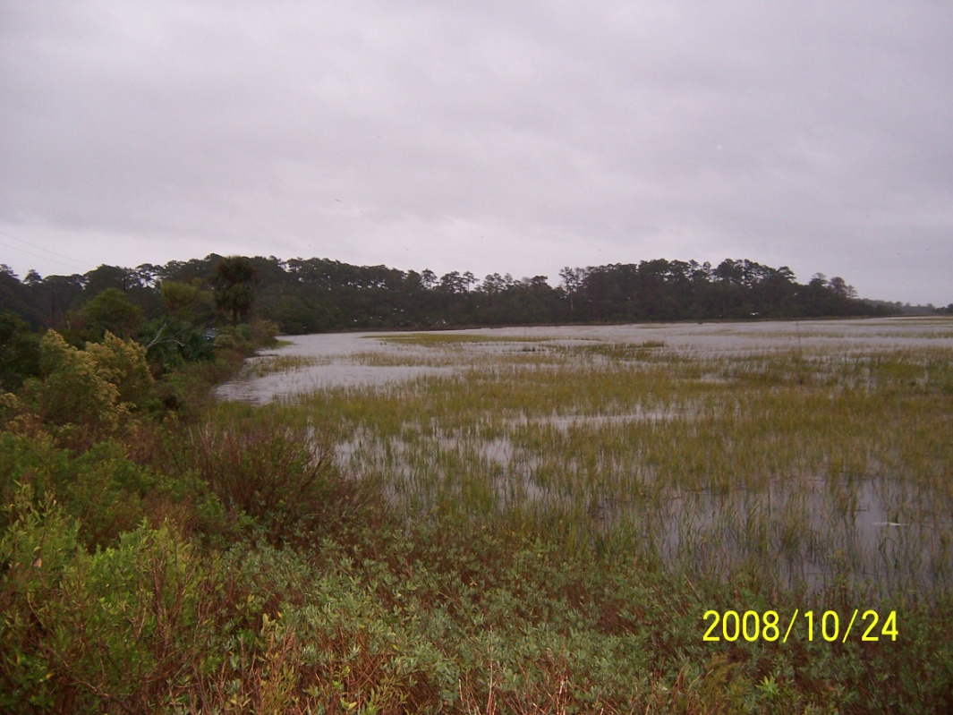
В ЧЕМ ВЫИГРЫШ БИОРАЗНООБРАЗИЯ?
Функциональность экосистем
Эксплуатационные свойства экосистемы
  Очистка воды,
  Очистка воздуха,
  Районы для местообитание и размножения представителей дикой природы …
Эстетичность

Slide 8
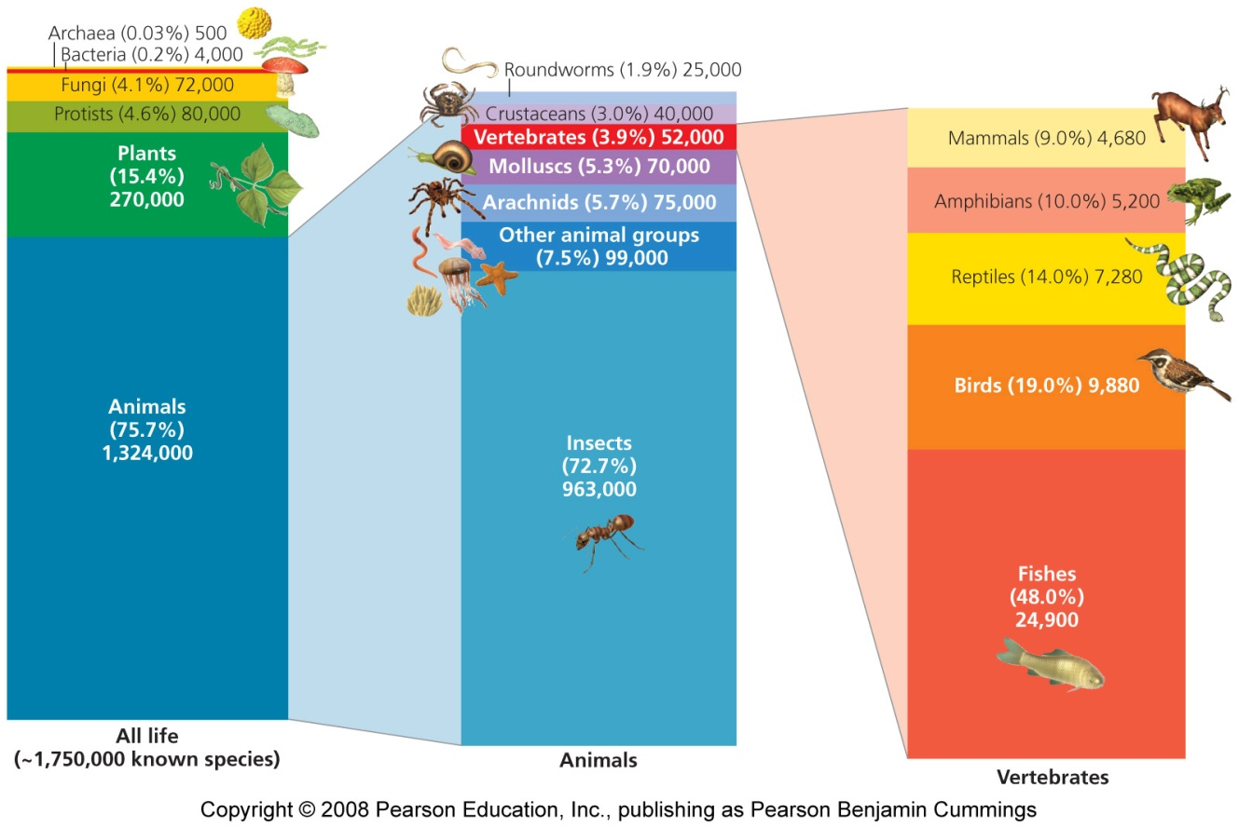
БИОРАЗНОБРАЗИЕ
  1.7—2.0 млн. видов - установлено
  До100 млн. - оценивается

Slide 9
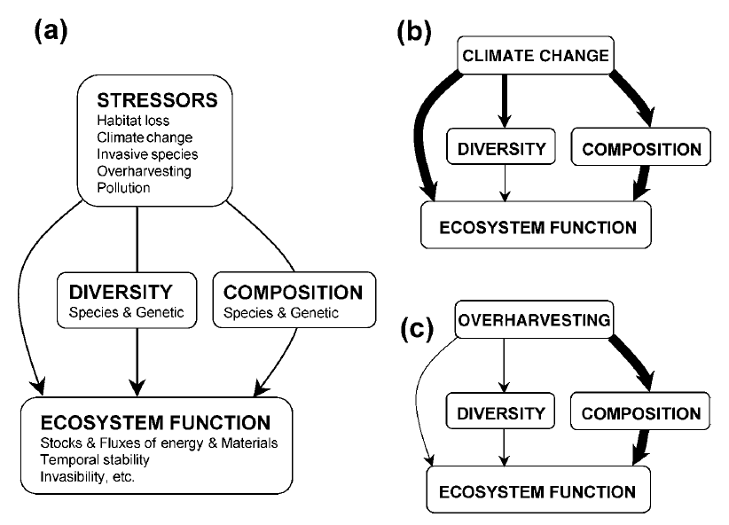
ВЛИЯНИЕ СТРЕССОВЫХ ВОЗДЕЙСТВИЙ НА ФУНКЦИОНИРОВАНИЕ ЭКОСИСТЕМЫ

Slide 10
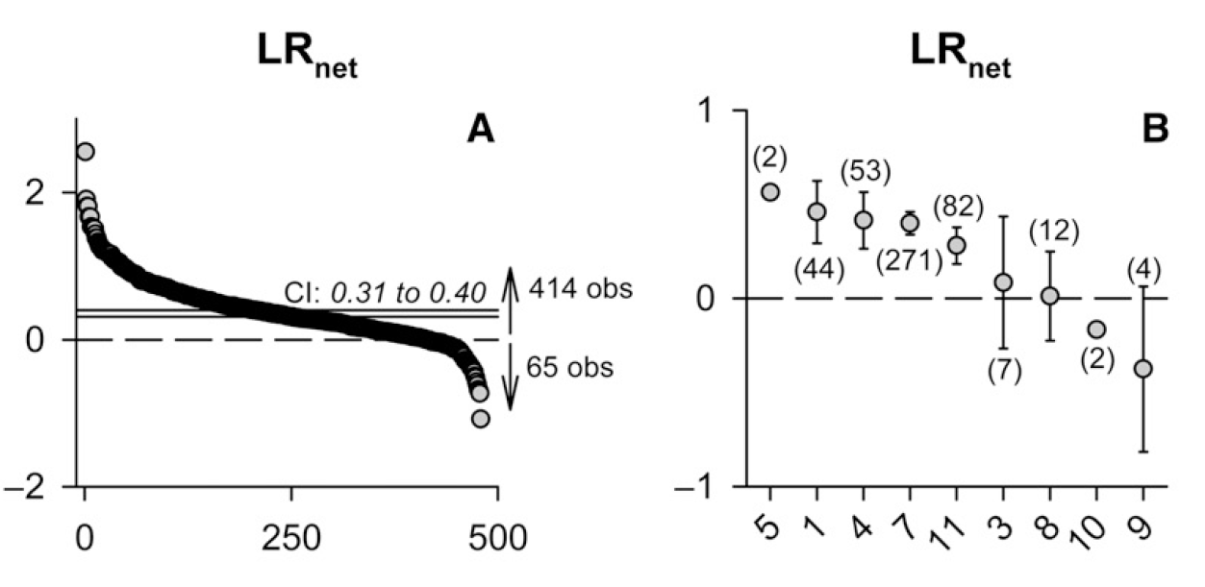


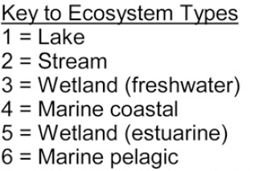
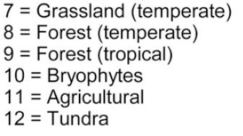
ВЛИЯЕТ ЛИ РАЗНООБРАЗИЕ ПРОДУЦЕНТОВ НА ЭФФЕКТИВНОСТЬ И ПРОДУКТИВНОСТЬ ЭКОСИСТЕМ?

Slide 11

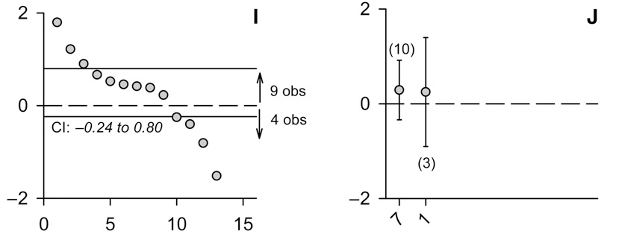
ВЛИЯЮТ ЛИ ПРОДУЦЕНТЫ НА РАЗНООБРАЗИЕ
ПЕРВИЧНЫХ КОНСУМЕНТОВ?

Slide 12
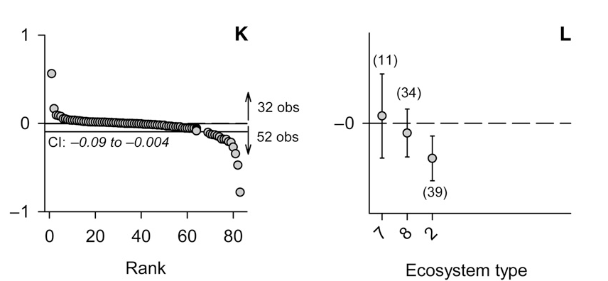

ВЛИЯЕТ ЛИ РАЗНООБРАЗИЕ ПРОДУЦЕНТОВ НА СКОРОСТЬ РАЗЛОЖЕНИЯ?

Slide 13
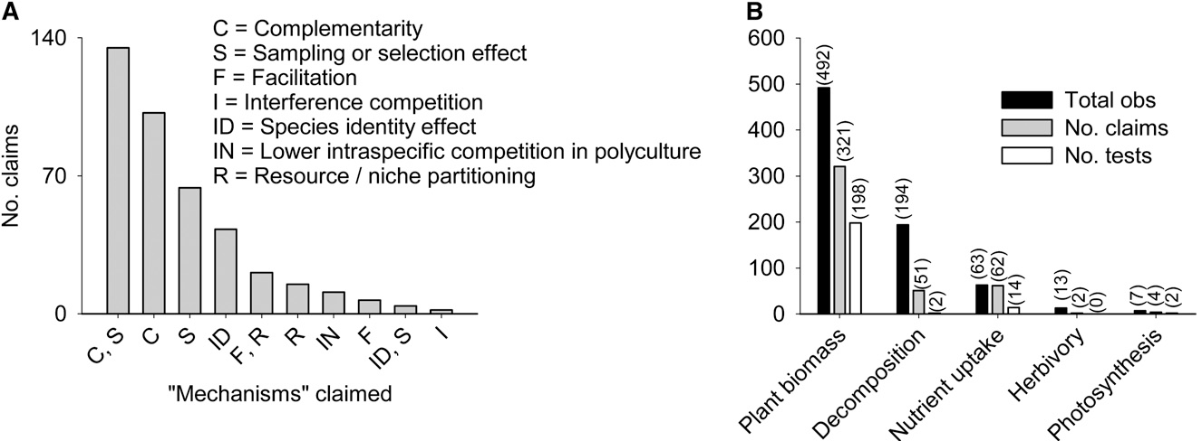
КАКИЕ МЕХАНИЗМЫ ОТВЕТСТВЕННЫ ЗА ВОЗДЕЙСТВИЯ БИОРАЗООБРАЗИЯ НА ФУНКЦИОНИРОВАНИЕ ЭКОСИСТЕМЫ

Slide 14
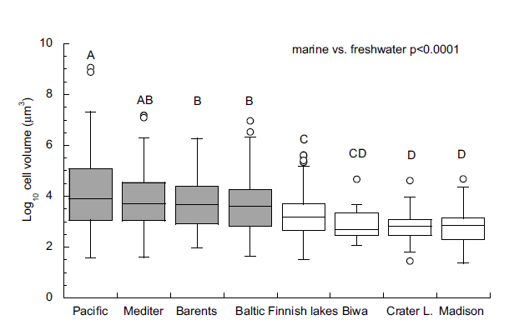
ОБЪЕМ КЛЕТОК ПРЕСНОВОДНЫХ И МОРСКИХ ДИАТОМОВЫХ ВОДОРОСЛЕЙ
Litchman, E et al (2009). Contrasting size evolution in marine and freshwater diatoms. Proceedings of the National Academy of Sciences, 106(8), 2665-2670.

Slide 15
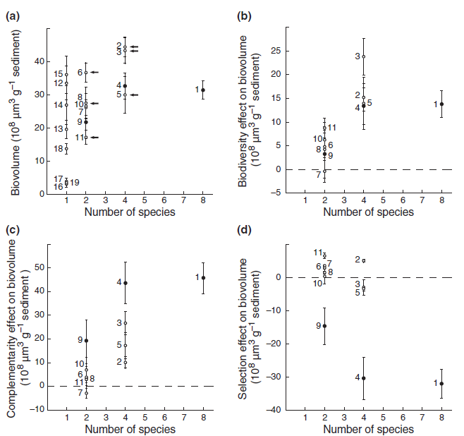
ВЛИЯНИЕ БИОРАЗНООБРАЗИЯ НА ФУНКЦИОНАЛЬНОСТЬ ЭКОСИСТЕМ
Vanelslander et al. (2009). Complementarity effects drive positive diversity effects on biomass production in experimental benthic diatom biofilms. Journal of Ecology, 97(5), 1075-1082.
Notes:
Effects of diatom diversity on (a) biomass yield, (b) net biodiversity effect (the difference between the observed yield of the
mixture and the expected yield, Loreau & Hector 2001), (c) complementarity effects and (d) selection effects (sensu Loreau & Hector 2001). Arrows indicate the treatments where transgressive overyielding (Dmax) occurred. The numbers denote the different treatments as defined in Table 1. Open circles represent treatments without Cylindrotheca closterium, filled circles represent treatments which contain C. closterium

Slide 16
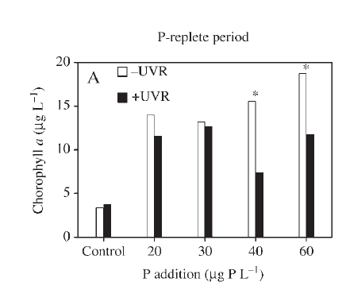
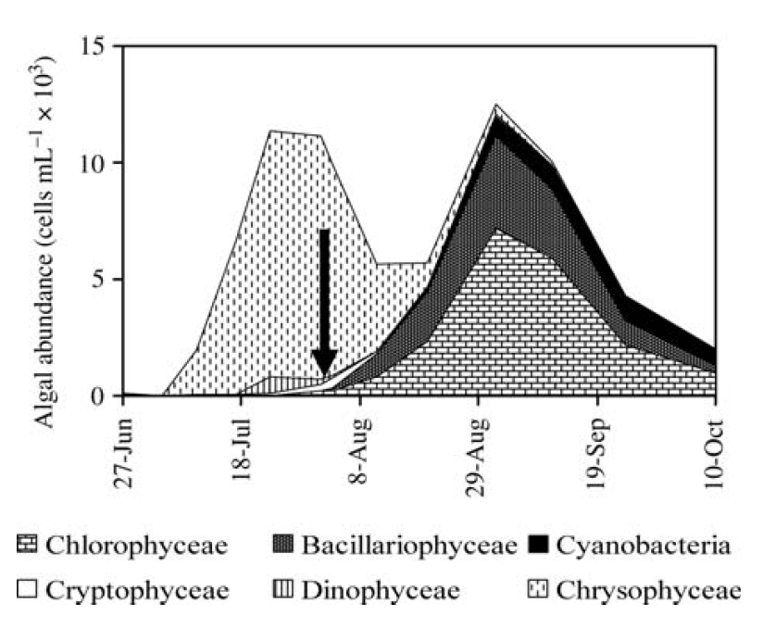
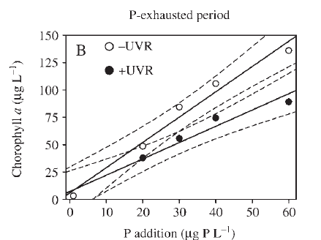
КУММУЛЯТИВНОСТЬ АНТРОПОГЕННЫХ ФАКТОРОВ НА БИОРАЗНООБРАЗИЕ И ФУНКЦИОНАЛЬНОСТЬ ЭКОСИСТЕМ
Delgado-Molina et al. (2009). Interactive effects of phosphorus loads and ambient ultraviolet radiation on the algal community in a high-mountain lake. Journal of plankton research, 31(6), 619-634.
Notes:
Temporal shift in specific algal composition in La Caldera Lake during ice-free period of 2003. Arrow represents the starting date of the experiment (1 August

Slide 17
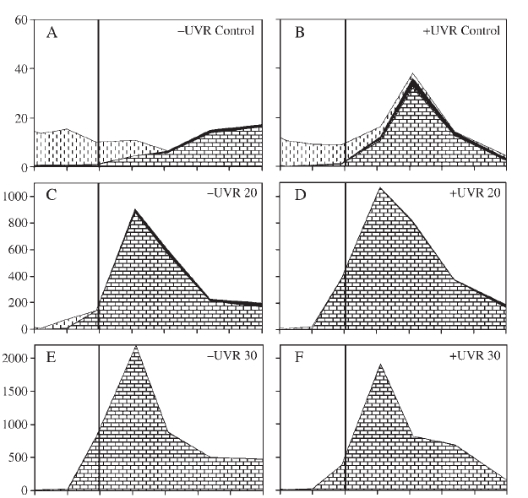
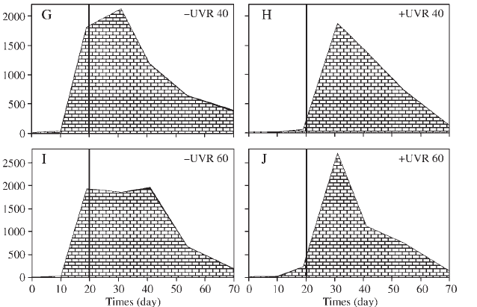


КУММУЛЯТИВНОСТЬ АНТРОПОГЕННЫХ ФАКТОРОВ НА БИОРАЗНООБРАЗИЕ И ФУНКЦИОНАЛЬНОСТЬ ЭКОСИСТЕМ
Delgado-Molina et al. (2009). Interactive effects of phosphorus loads and ambient ultraviolet radiation on the algal community in a high-mountain lake. Journal of plankton research, 31(6), 619-634.

Slide 18
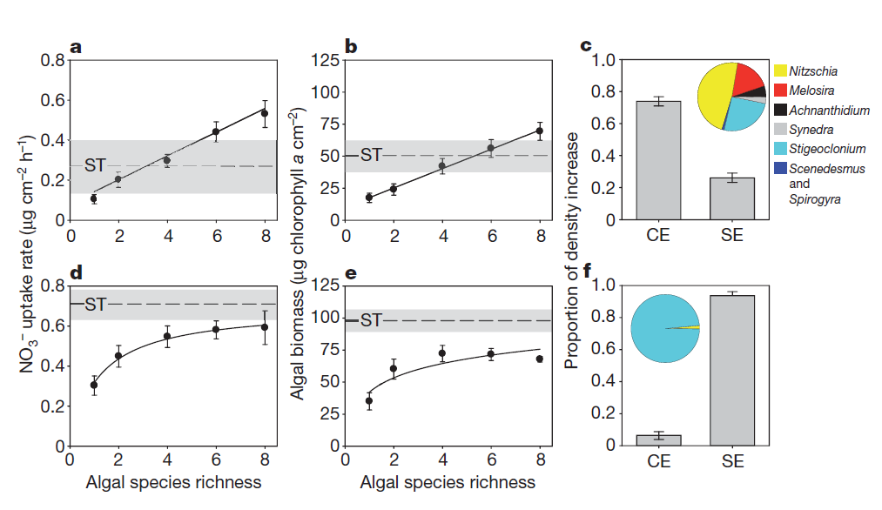
РОЛЬ БИОРАЗНОБРАЗИЯ В УМЕНЬШЕНИИ ВЛИЯНИЯ АНТРОПОГЕННЫХ ФАКТОРОВ
Cardinale, B. J. (2011). Biodiversity improves water quality through niche partitioning. Nature, 472(7341), 86-89.
Notes:
Algal diversity effects on NO3 2, algal biomass and final population sizes. a–c, Heterogeneous streams, with flow varying spatially anв habitats varying in successional age. d–f, Homogeneous streams, in which niche opportunities had been removed. Data are presented as mean6s.e.m. Of 24 replicates for monocultures, 15 replicates for 2–6 species polycultures and 6 replicates for 8-species polycultures. Best fitting functions (Table 1) are plotted as solid lines. The horizontal line and the grey shaded area show mean6s.e.m. for Stigeoclonium, which achieved the highest values of all of the monocultures. c, f, The proportion of increased polyculture cell densities driven by niche complementarity (CE) or selection effects (SE; that is, the influence of dominant species).

Slide 19
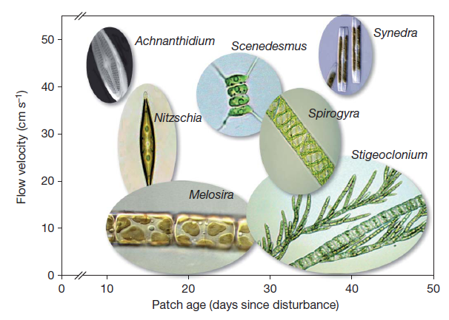
РОЛЬ БИОРАЗНОБРАЗИЯ В
УМЕНЬШЕНИИ ВЛИЯНИЯ АНТРОПОГЕННЫХ ФАКТОРОВ
Cardinale, B. J. (2011). Biodiversity improves water quality through niche partitioning. Nature, 472(7341), 86-89.
Notes:
The ovals show the mean (centre of image)695% confidence interval (boundary of image) of cell densities along two axes of a species niche (successional age of habitat and near-bed velocity). Filamentous algae that are susceptible to shear (Melosira and Stigeoclonium) were abundant in low-velocity habitats. Single-celled diatoms that grow prostrate to a surface (Achnanthidium and Synedra) achieved the highest densities in high-velocity habitats. Early successional habitats were dominated by small diatoms with fast rates of growth (Achnanthidium and Nitzschia), whereas late successional habitats were dominated by slow-growing cells,
colonies or filaments (Stigeoclonium, Spirogyra and Synedra). Navicula is not plotted, because it failed to establish itself in polyculture despite growing in monoculture.

Slide 20
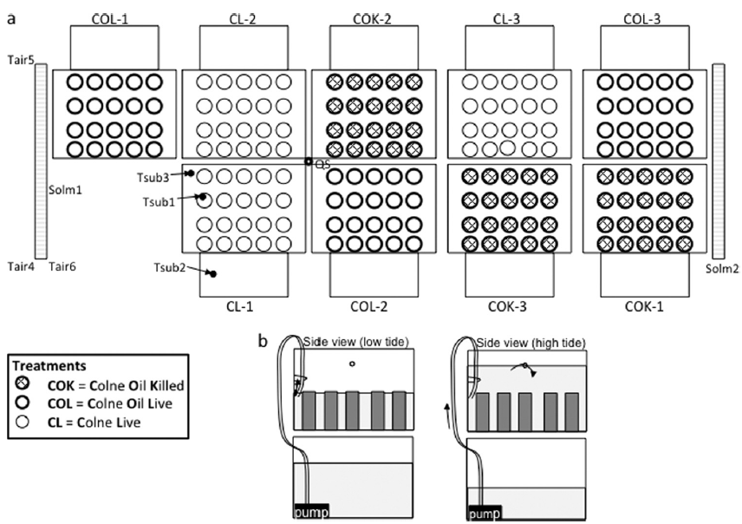
РОЛЬ БИОРАЗНОБРАЗИЯ В УМЕНЬШЕНИИ ВЛИЯНИЯ АНТРОПОГЕННЫХ ФАКТОРОВ ?
Coulon et al.(2012). Central role of dynamic tidal biofilms dominated by aerobic hydrocarbonoclastic bacteria and diatoms in the biodegradation of hydrocarbons in coastal mudflats. Applied and environmental microbiology, 78(10), 3638-3648.
Notes:
Schematic representation of the experimental tidal mesocosms. (a) Surface view of nine polypropylene containers (32.5 by 42 by 25.5 cm) holding 20
sediment cores (9.8 cm high and 6.5 cm in diameter) that were placed above reservoir containers. Three different treatments were carried out in triplicate, as
follows: (i) autoclaved sediment cores with Forties crude oil (Colne oil killed [COK]), (ii) sediment cores with Forties crude oil (Colne oil live [COL]), and (iii)
sediment core without oil (Colne live [CL]). Tair, air temperature probe; Tsub1, temperature probe in sediment; Tsub2, temperature probe in water reservoir
tank; Tsub3, temperature probe in water tank containing cores; Solm, tube solar energy sensors; QS, spot sensors for solar energy in the photosynthetically active
waveband. (b) Side view of the upper container holding the sediment cores and the lower reservoir, illustrating the flow of seawater. At low tide, the pump was
off, and seawater drained to the level of the tube connected to the pump. At high tide, the pump was on, and seawater flowed continuously through a tube passing
through the hole. The tube was curved downwards into the upper tank to prevent the transfer of oil from the upper tank to the reservoir

Slide 21
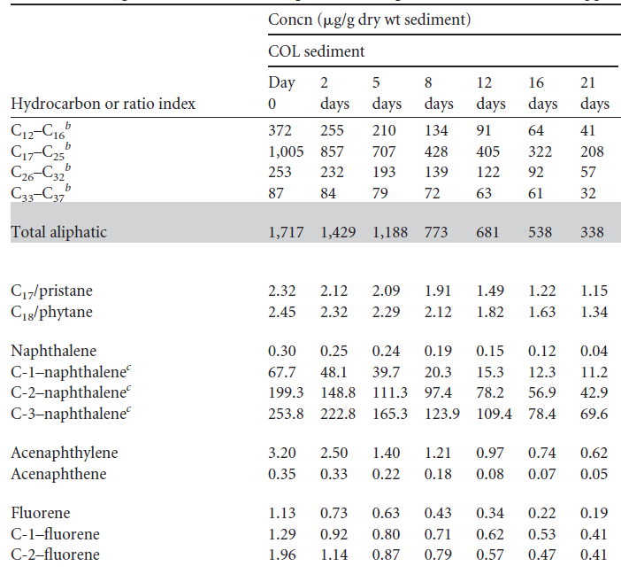
РОЛЬ БИОРАЗНОБРАЗИЯ В УМЕНЬШЕНИИ ВЛИЯНИЯ АНТРОПОГЕННЫХ ФАКТОРОВ ?
Coulon et al.(2012). Central role of dynamic tidal biofilms dominated by aerobic hydrocarbonoclastic bacteria and diatoms in the biodegradation of hydrocarbons in coastal mudflats. Applied and environmental microbiology, 78(10), 3638-3648.

Slide 22
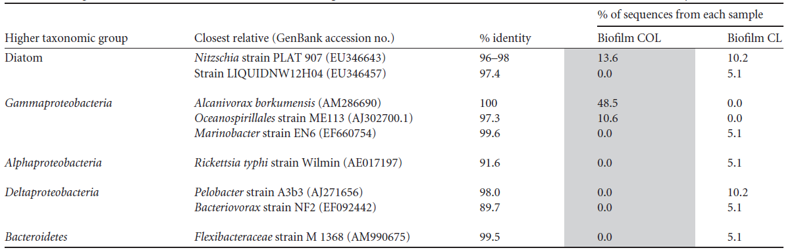
РОЛЬ БИОРАЗНОБРАЗИЯ В УМЕНЬШЕНИИ ВЛИЯНИЯ АНТРОПОГЕННЫХ ФАКТОРОВ ?
Comparison of the main taxa detected in 16S rRNA gene clone libraries from the oiled and nonoiled tidal biofilms at day 22a
Coulon et al.(2012). Central role of dynamic tidal biofilms dominated by aerobic hydrocarbonoclastic bacteria and diatoms in the biodegradation of hydrocarbons in coastal mudflats. Applied and environmental microbiology, 78(10), 3638-3648.

